Slide 1
Improving Language Understanding by Generative Pre-Training
Alec Radford Karthik Narasimhan Tim Salimans Ilya Sutskever
Speakers:
Gengcheng
Haoxue
Mohammad
Nurul

Slide 2
Contents
Introduction and Related Work
Framework
Experiment
Analysis and Conclusion

Slide 3
Introduction
Deep learning methods need a lot of labelled data
Labelled Data = Expensive, Time-consuming
Alternative
Learning from unlabelled data
Models that understand language without labels or use pre-trained word knowledge can perform much better[8, 11, 26, 45].
Challenges
What are best goals for learning useful text meanings?
How to apply them to specific tasks?

Slide 4
Introduction
Our research
Semi-supervised learning using Transformer
mix of unsupervised pre-training and supervised fine-tuning
Aim
A universal model that works well for various tasks
Requires minimal adjustments,
utilizes a large amount of unlabelled text and several manually annotated training examples datasets.
Evaluation
natural language inference, question answering, semantic similarity, and text classification

Slide 5
Related Work
Similar research to our work
pre-training a neural network using a language modelling objective and then fine-tuning it on a target task with supervision*.
However, although the pre-training phase helps capture some linguistic information, their usage of LSTM models restricts their prediction ability to a short range
Our work
Using Transformer to capture longer linguistic structures.
Using unsupervised pre-training, aiming to find a good starting point for training deep neural networks.
And supervised fine-tuning for a specific target task
* Dai et al. [ 13] and Howard and Ruder [21] follow this method to improve text classification.

Slide 6
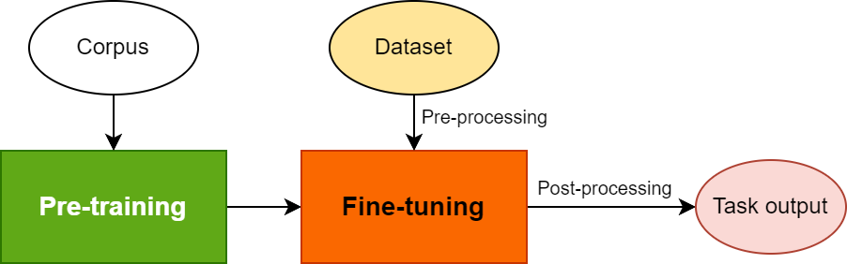
Framework
The training procedure of GPT-1 consists of two stages: Pre-training, Fine-tuning;
First stage for extracting the context features of each single token;
Second stage for adapting the model to different downstream task.
This later become the main paradigm of training the language model.

Slide 7
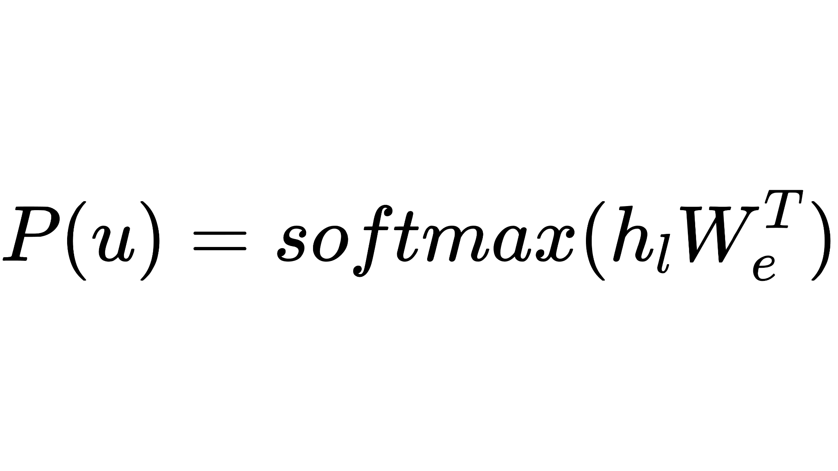
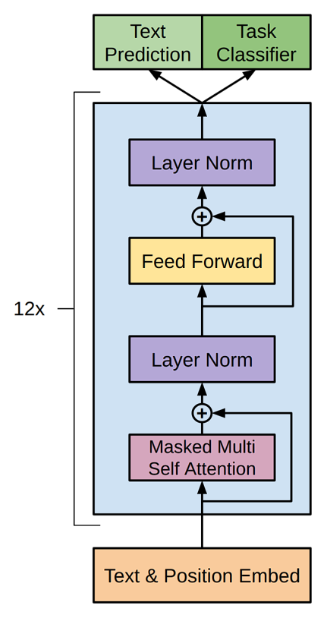
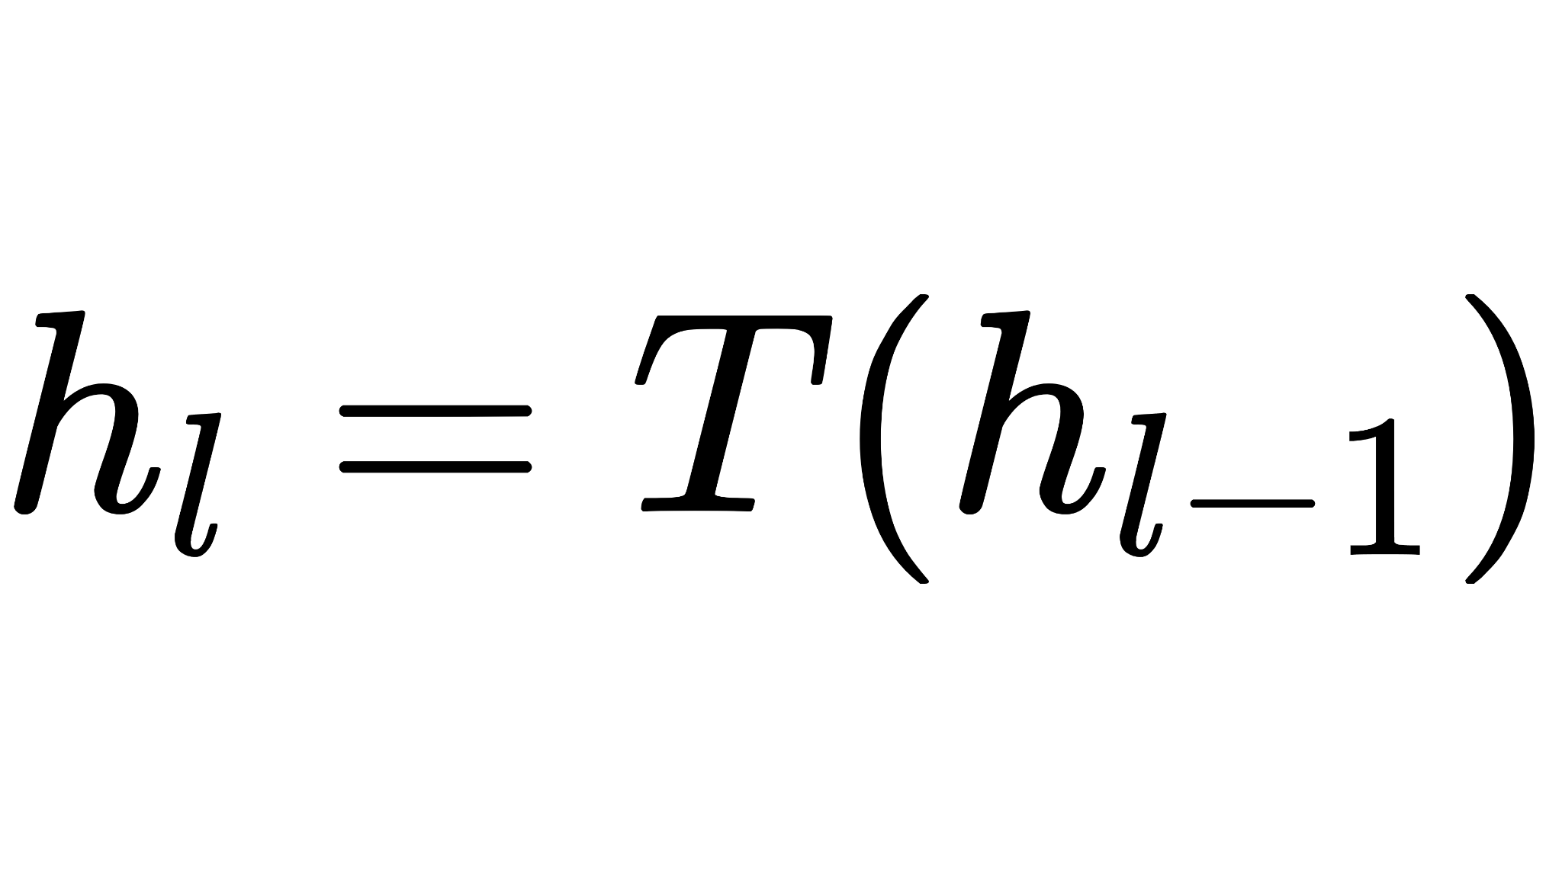
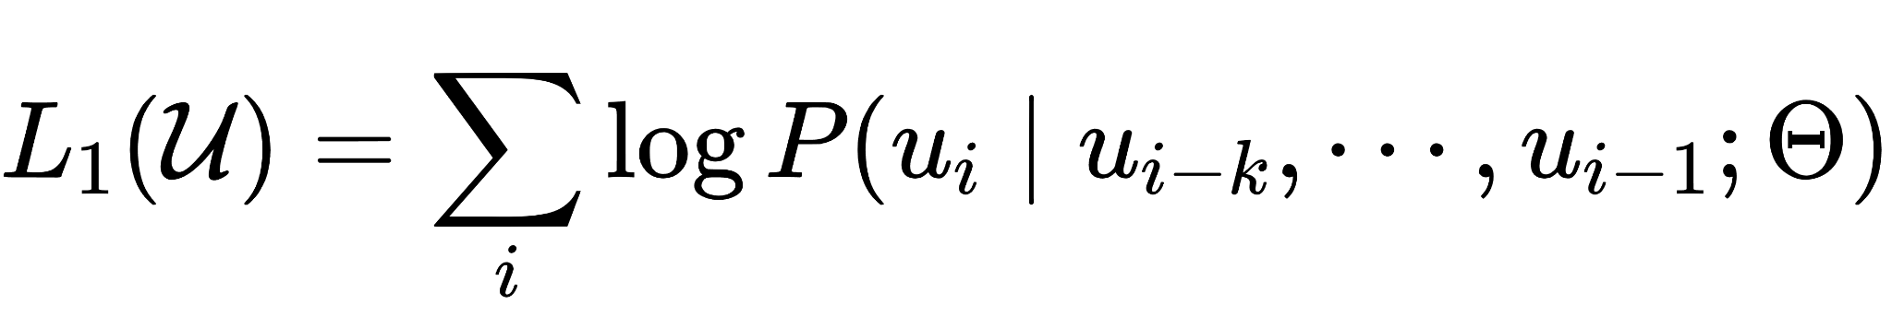
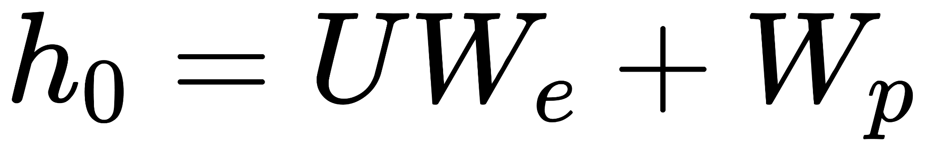

Stage 1 Unsupervised pre-training
Steps:
Input the context tokens with token embeddings and position embedding;
Then process all the tokens with 12x transformer decoder blocks;
Finally multiply the hidden states with token embeddings, and get the probability of next token with Softmax.
Objective here is the sum of logarithms of probs on each tokens by using previous tokens.
This means to make network parameters can extract the generalized context features as much as possible on corpus.

Slide 8
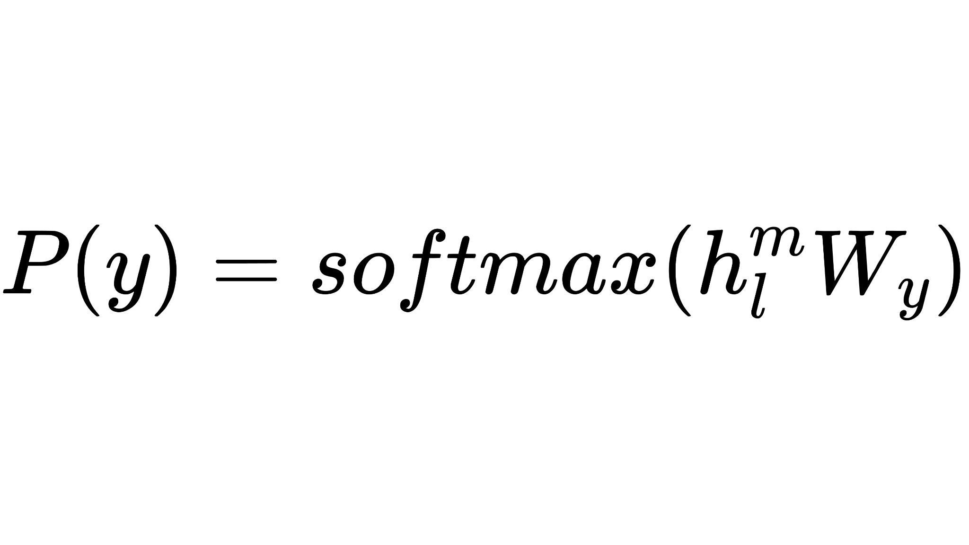
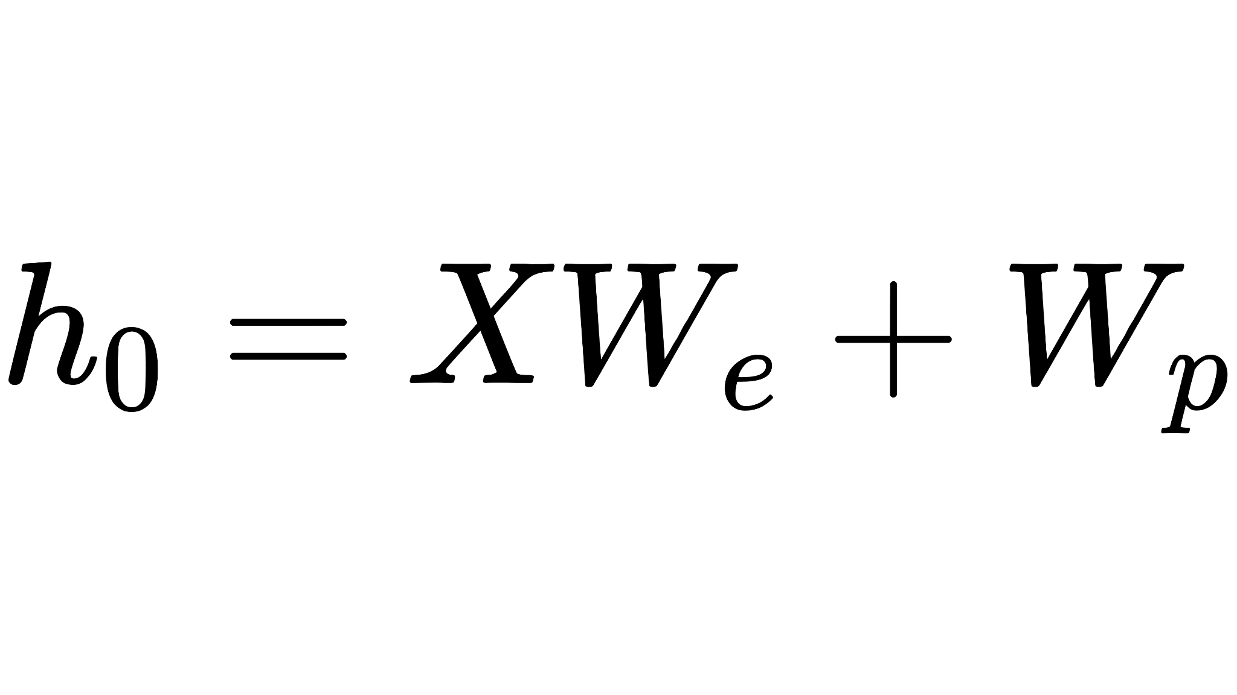
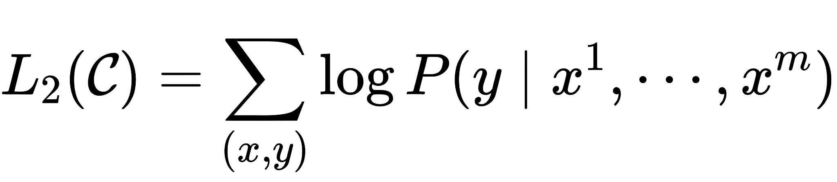

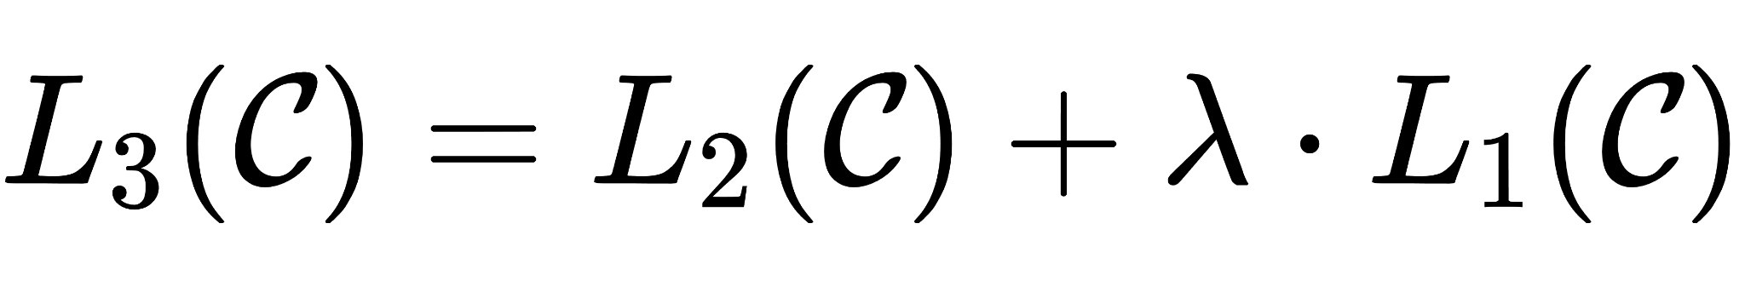
Stage 2 Supervised fine-tuning
Steps:
Input the context tokens with learned token embeddings and position embedding;
Then process all the tokens with 12x transformer decoder blocks;
Finally multiply the hidden states with task embeddings, and get the probability of next token with Softmax.
Objective here includes 2 parts: task objective, auxiliary objective with weights;
Task objective leads model go directly to reach the target labels, and auxiliary objective is the same objective as context, which will generalize the model and accelerate the convergence.

Slide 9
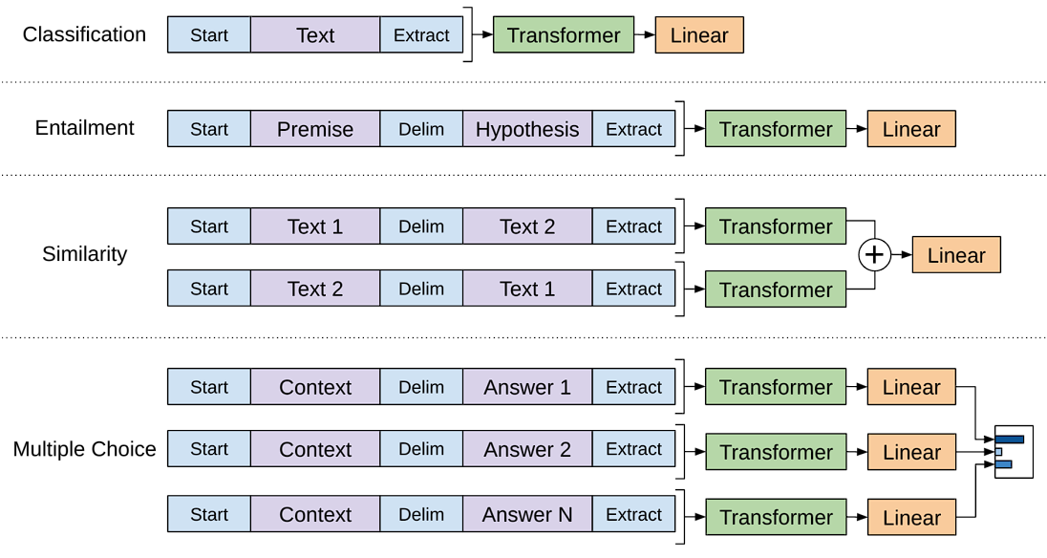
Task-specific input transformations
Make model compatible for every language task by using some preprocessing techniques:
Use Start, Delimiter, Extract(End) tokens to connect the inputs.
The GPT-1 uses traversal-style approach to convert structures inputs into an ordered sequence.
For instances,
Classification: only add the start, and extract.
Entailment: connect the Premise and Hypothesis with one delimiter, then add start and extract.

Slide 10
Similarity: modify the input sequence to contain both possible sentence orderings with delimiter between.
Multiple Choice: connect context with each possible answers by using delimiter, and independently input them into Transformer and Linear blocks, then normalized via a softmax layer to produce an output distribution over possible answers.

Slide 11
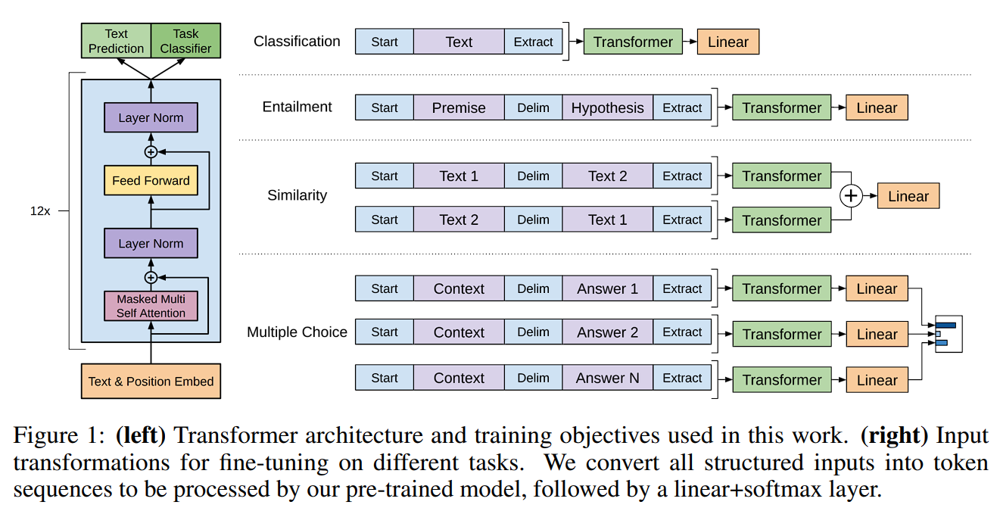

Slide 12
Experiment Setup
Unsupervised pre-training
BookCorpus dataset (7000 unique unpublished books)
unidirectional (left-to-right) context
Supervised fine-tuning
specific input representations
less fine-tuning compared to GPT2&3

Slide 13
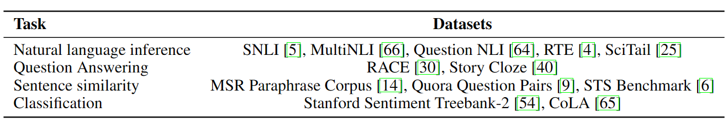
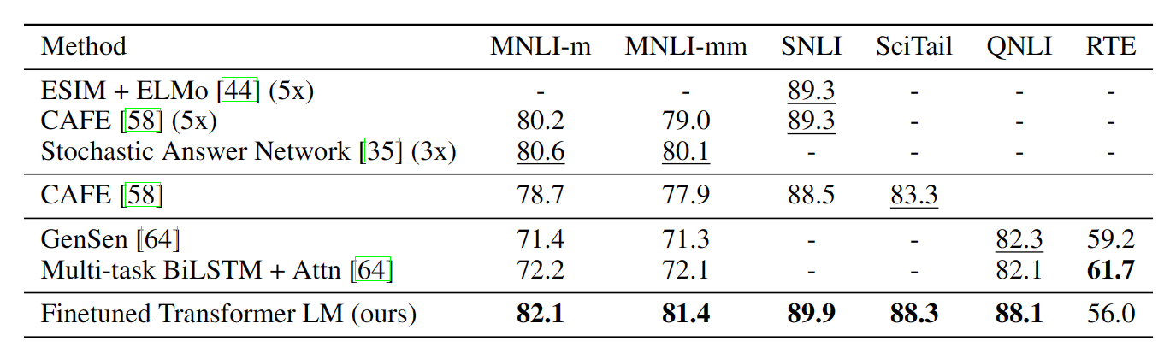
Natural Language Inference

Slide 14
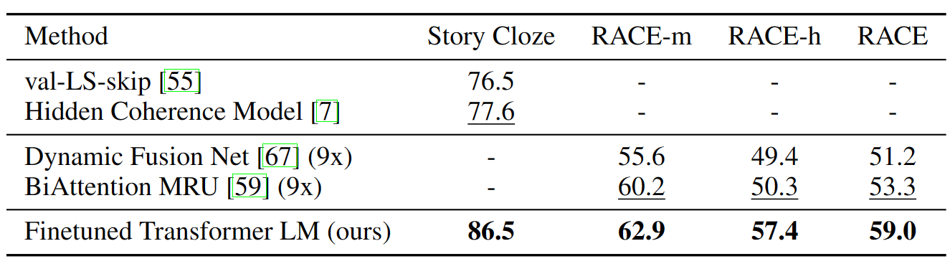
Question answering and commonsense reasoning

Slide 15
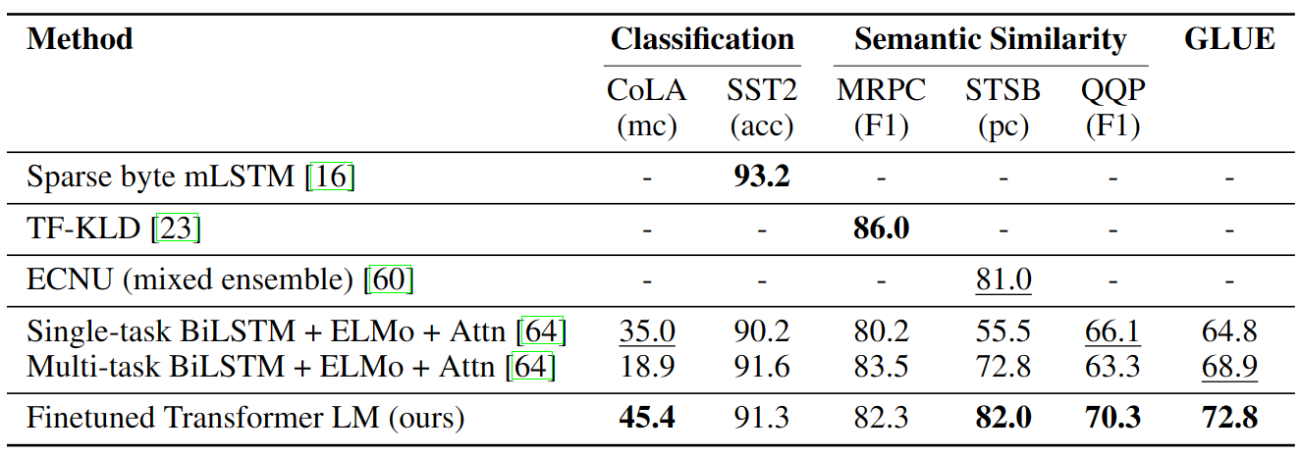
Semantic similarity and classification

Slide 16
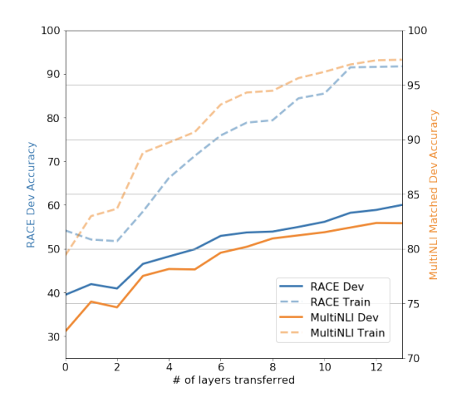
Analysis
Impact of number of layers transferred
Standard result that transferring embeddings improves performance
Each transformer layer provides further benefits up to 9% for full transfer on MultiNLI
Each layer in the pre-trained model contains useful functionality for solving target tasks.
Effect of transferring increasing number of layers from the pre-trained language model on RACE and MultiNLI.

Slide 17
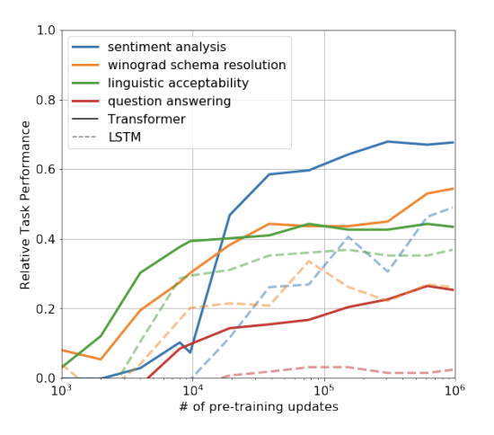
Analysis
Zero-shot Behaviors
We designed a series of heuristic solutions that use the underlying generative model to perform tasks without supervised finetuning
Performance of these heuristics is stable and steadily increases over training suggesting that generative pretraining supports the learning of a wide variety of task relevant functionality
LSTM exhibits higher variance in its zero-shot performance suggesting that the inductive bias of the Transformer architecture assists in transfer
Evolution of zero-shot performance on different tasks as a function of LM pre-training updates. Performance per task is normalized between a random guess baseline and the current state-of-the-art with a single model

Slide 18
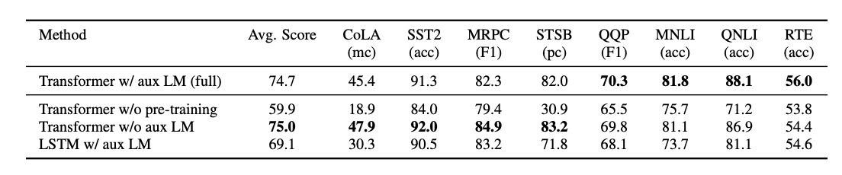
Ablation studies
Analysis of various model ablations on different tasks. Avg. score is a unweighted average of all the results. (mc= Mathews correlation, acc=Accuracy, pc=Pearson correlation)

Slide 19
Analysis
Ablation Studies
Examine the performance of our method without the auxiliary LM objective during fine-tuning shows that the auxiliary objective helps on the NLI tasks and QQP. Overall, the trend suggests that larger datasets benefit from the auxiliary objective but smaller datasets do not
Analyzing the effect of the Transformer by comparing it with a single layer 2048 unit LSTM using the same framework shows a 5.6 average score drop when using the LSTM instead of the Transformer. The LSTM only outperforms the Transformer on one dataset – MRPC
Comparing with our transformer architecture directly trained on supervised target tasks, without pre-training shows that the lack of pre-training hurts performance across all the tasks, resulting in a 14.8% decrease compared to our full model

Slide 20
Conclusion
A task-agnostic model using generative pre-training and discriminative fine-tuning is introduced
Pre-training on a diverse corpus with long contiguous text for significant world knowledge and handling long-range dependencies
Transferring knowledge to discriminative tasks (e.g., question answering, semantic similarity assessment, entailment determination, text classification)
Improving state-of-the-art performance on 9 of the 12 studied datasets
Demonstrating the effectiveness of unsupervised (pre-)training, addressing a long-standing goal in Machine Learning research

